Slide 1
Impact of Air Pollution on Children with Sickle Cell Disease
Paul George
Mentor: Joseph Lipscomb
Fall Research Retreat, 2022

Slide 2
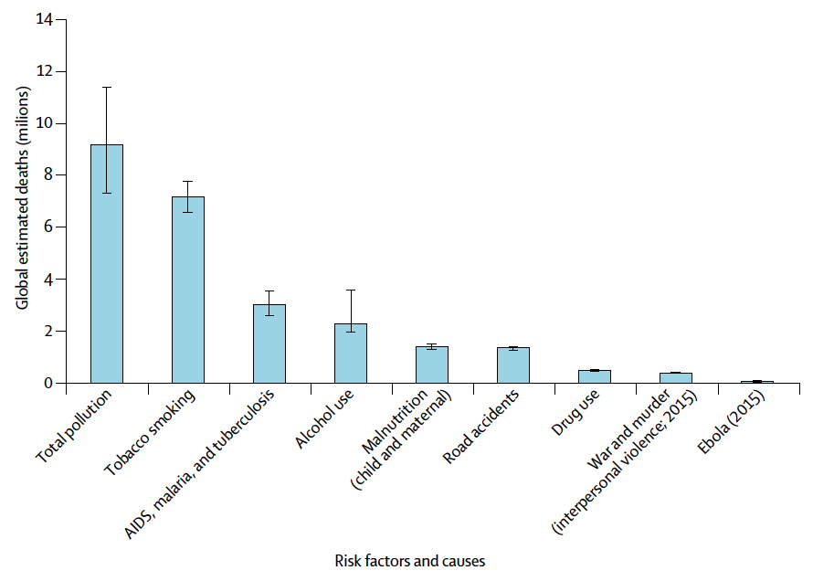
Air pollution is a major cause of morbidity/mortality
Figure 1: Global estimated deaths by major risk factor/cause
Figure 1 shows the estimated causes of death (millions) globally from a variety factors. Figure taken from Landrigan, Philip J., et al. "The Lancet Commission on pollution and health." The Lancet 391.10119 (2018): 462-512.
Notes:
Estimates, but underscores just how impactful pollution can be to human health

Slide 3
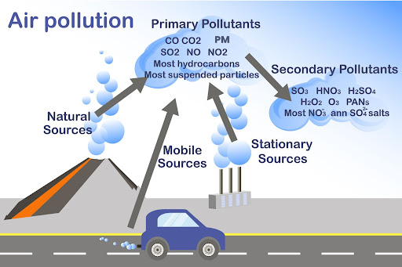
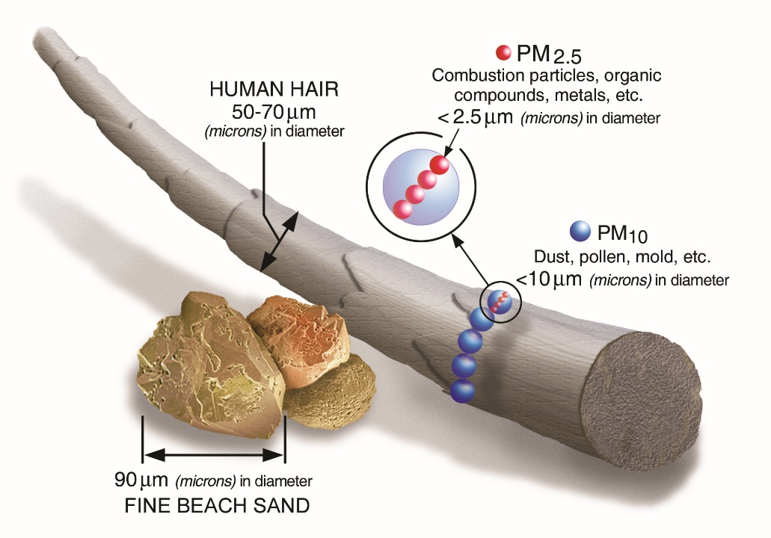
Air pollution components
Source: https://www.clarity.io/blog/how-measuring-different-types-of-air-pollutants-creates-a-more-holistic-picture-of-air-pollution,
www.epa.gov/pm2.5
Notes:
Mixture of different particles and compounds
Reason I wanted to focus on PM2.5 is it’s the most well-studied of all pollutants, and the one that’s thought to be most damaging to human health

Slide 4
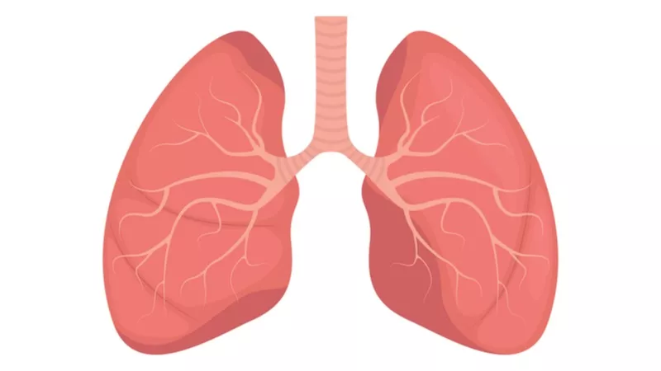
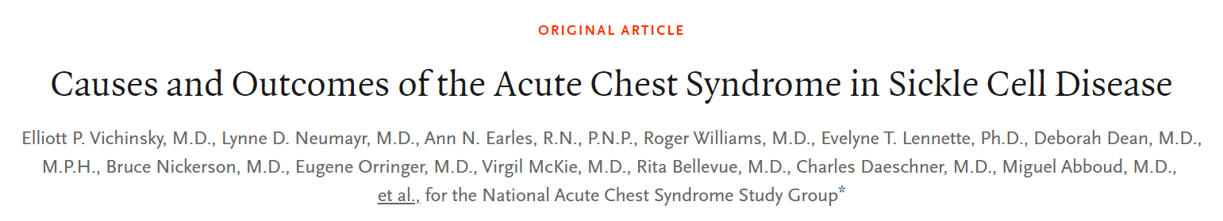
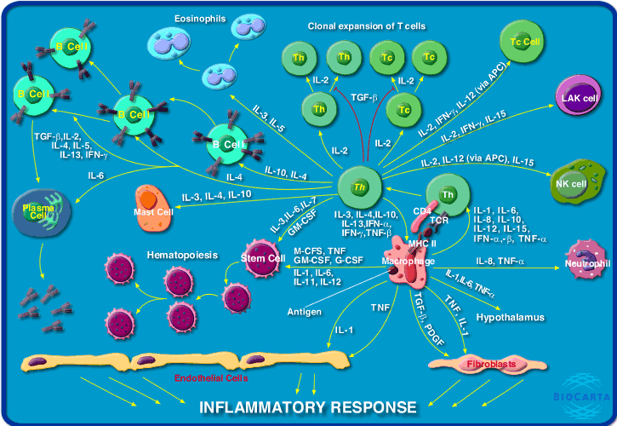

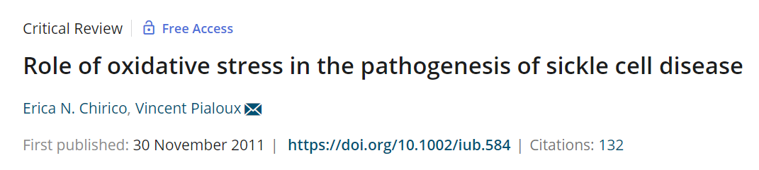
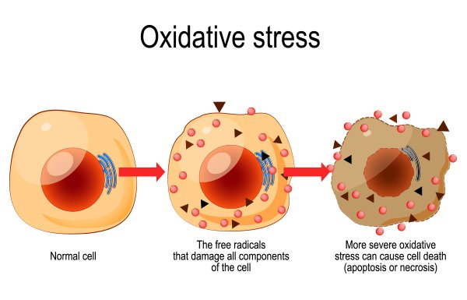
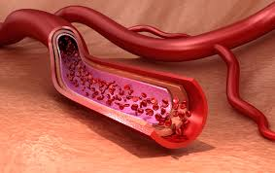


Slide 5
Hypothesis of study
Central hypothesis is that exposure to air pollution (PM_{2.5}, CO, NO2, ozone) is a key risk factor for the development of severe complications of SCD (ED visits).
Notes:
At both an population-wide and individual level

Slide 6
Project 1 population-wide project

Slide 7
Project 1 – Population-wide analysis
Hypothesis – number of ED visits per day will be positively correlated with pollutant levels
Outcome of interest – number of ED visits per day amongst the cohort (count variable)
Exposure of interest – city-wide average of daily pollutant levels (rolling 3 day average)
Control for: time trends, season, and weather

Slide 8
103,979 visits
3,384 unique patients
From January 1, 2010 – December 31, 2018, there were 103,979 total outpatient visits across the 3 campuses, representing 3,384 unique children with SCD.
Notes:
Couldn’t do this study elsewhere, we have both the patients and the database available

Slide 9
103,979 visits
3,384 unique patients
Non-ED
29,795 visits
2,812 patients
Age
26,673 visits
2,644 patients
Address (distance from nearest CHOA ED)
18,086 visits
1,784 patients
LTFU (loss to follow up)
17,731 visits
1,740 patients
Notes:
Couldn’t do this study elsewhere

Slide 10
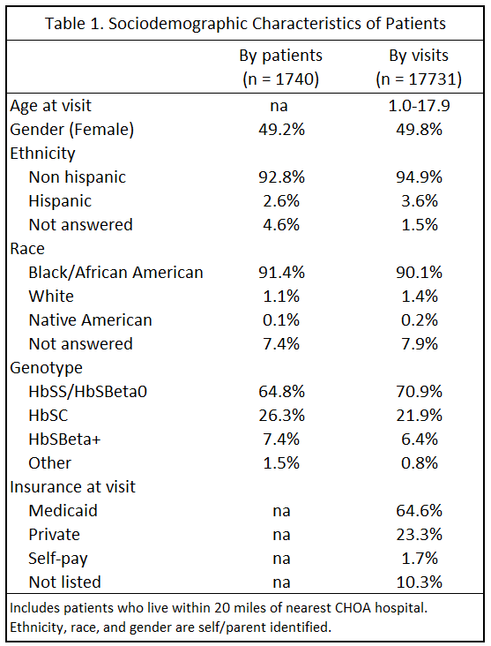

Slide 11
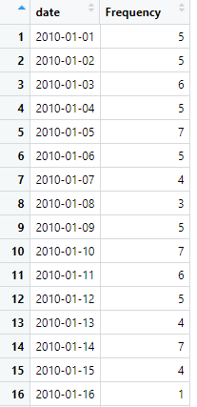
Final ED Database

Slide 12

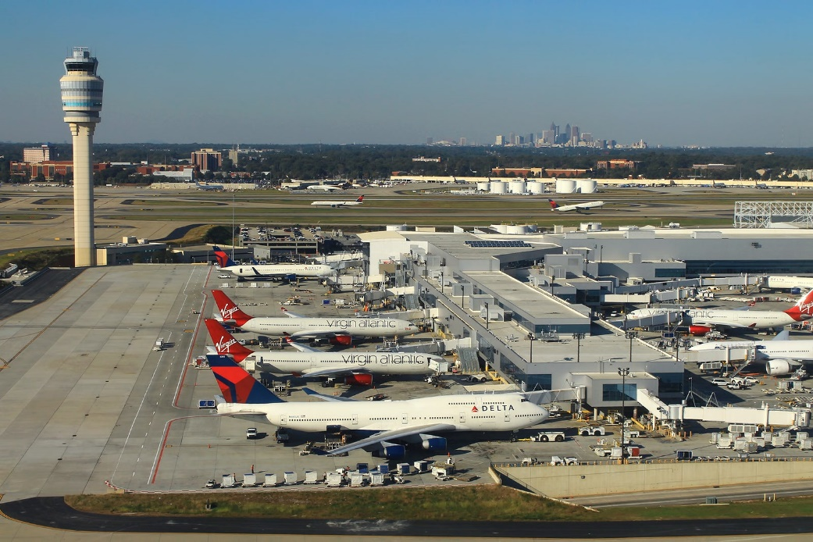
Exposure Database

Slide 13
Project 1 – Population-wide analysis
Hypothesis – number of ED visits per day will be positively correlated with pollutant levels
Outcome of interest – number of ED visits per day amongst the cohort (count variable)
Exposure of interest – city-wide average of daily pollutant levels (rolling 3 day average)
Control for: time trends, season, and weather

Slide 14
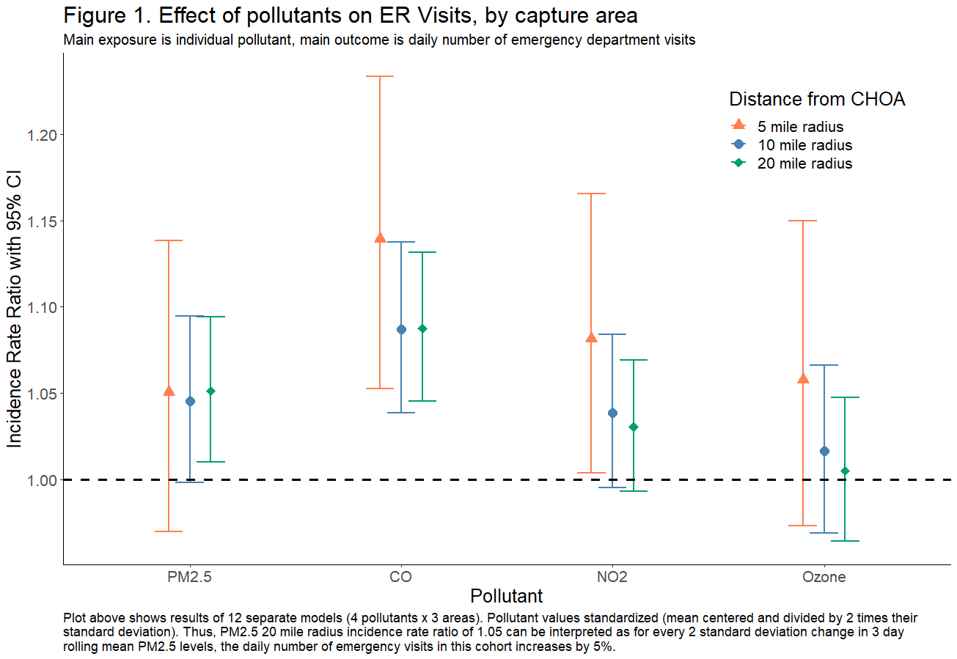
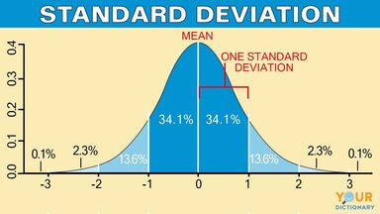
p = 0.015
IRR 1.051, for every 2 standard deviation change in PM2.5 levels, the daily number of ED visits in this cohort increases by 5.1%
Notes:
2 SD change is like going from the 50%ile to 97%ile,
Robustness

Slide 15
Notes:
2 SD change is like going from the 50%ile to 97%ile,
Robustness

Slide 16
Notes:
2 SD change is like going from the 50%ile to 97%ile,
Robustness

Slide 17
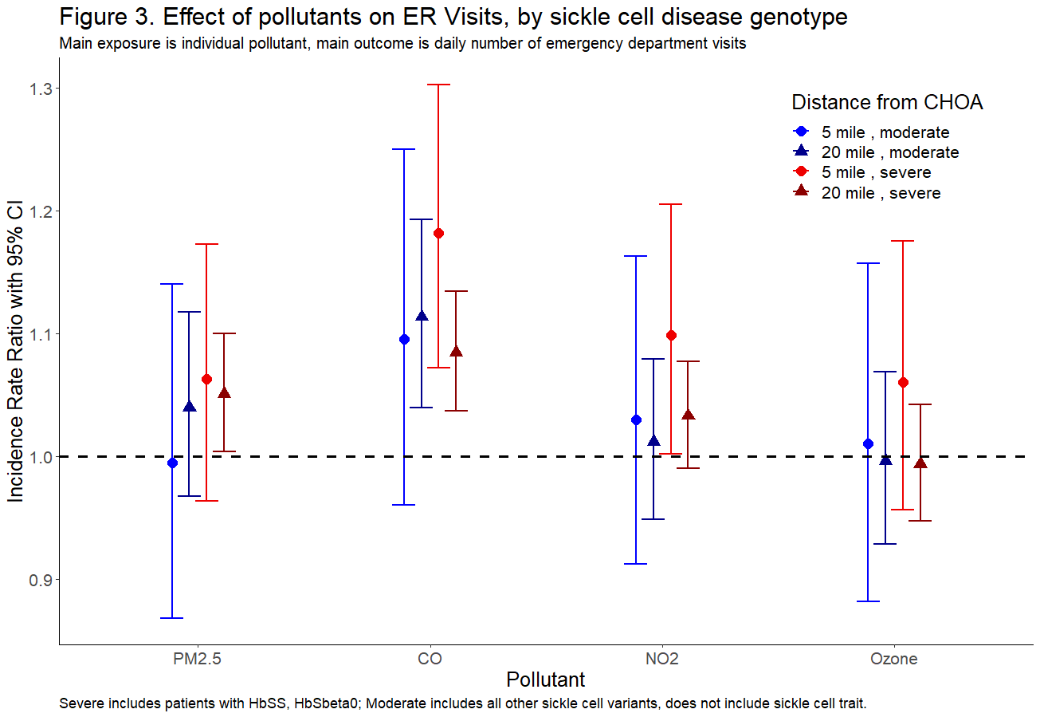
Severe (HbSS, HbSβ0)
vs
All other genotypes

Slide 18
So what?
Social justice issue
Find individuals at high risk for pollution’s harms
Exposure assessments
Avoidance strategies
Air filtration
Notes:
Gas grills and wood fires

Slide 19
Project 2 individual-focused project

Slide 20
Project 2 – Individual-focused analysis
Hypothesis – whether or not an individual patient has an ED visits on a given day will be positively correlated with pollutant levels in that individuals neighborhood
Outcome of interest – ED visit on each day (yes/no variable)
Exposure of interest – neighborhood PM_{2.5} value
Advantage – allows us to account for and estimate patient-level confounders (genotype, medication usage, neighborhood poverty levels)

Slide 21
Future Goals and Plans
PhD in Health Services Research (focus health economics)
Data analysis using large, complex data sets and natural experiments to uncover sociodemographic, clinical, and other key factors that affect health outcomes
Physician-scientist
Notes:
Economists historically haven’t had access to RCTs, so they have come up with a lot of good techniques for properly analyzing and inferring causality from retrospective data, and a lot of the topics I am interested in, like pollution, other social determinants of health, can’t be randomized
International programs like Global HOPE, governmental agencies such as CDC, USAID

Slide 22
Academic Achievements
Papers published
George, P. E., Stokes, C. et al. (2021). Covid‐19 will not “magically disappear”: Why access to widespread testing is paramount. American Journal of Hematology, 96(2), 174-178.
Garcia, P. J., George, P. E., et. al (2020). “The flu… is a little more complicated than a cold”: Knowledge, beliefs, and practices related to influenza and influenza vaccination among at-risk populations and health professionals in Peru. Vaccine, 38(48), 7688.
Otto, S. B. J., George, P. E., et. al. (2020). Cryptococcal meningitis and immune reconstitution inflammatory syndrome in a pediatric patient with HIV after switching to second line antiretroviral therapy: a case report. BMC infectious diseases, 20(1), 1-5.
Naturinda, E., George, P.E, et al. (2021). Transient bone marrow hypoplasia preceding T-Cell acute lymphoblastic leukemia: a case report. African Health Sciences, 21(2), 683-686.
Murphey, K, George, P.E., et al. (2022). Acute Myeloid Leukemia and Dilated Cardiomyopathy in a Pediatric Patient with D-2-Hydroxyglutaric Aciduria Type I. American Journ of Med. Genetics, 2707-2711.
Manuscripts in process
Current project
Rise of Technology Validation During COVID-19
Disparities in Access to Telemedicine Care
Trends in management of acute appendicitis
Grants applied for
ASH RTAF (finalist, not-funded)
F32 (resubmission, scores pending)

Slide 23
Thank you!
Dr. Joseph Lipscomb
Dr. Wilbur Lam
Dr. William Woods
Dr. Stefanie Ebelt
Dr. Peter Lane
Dr. Staci Arnold
All my clinic and other research mentors

Slide 24
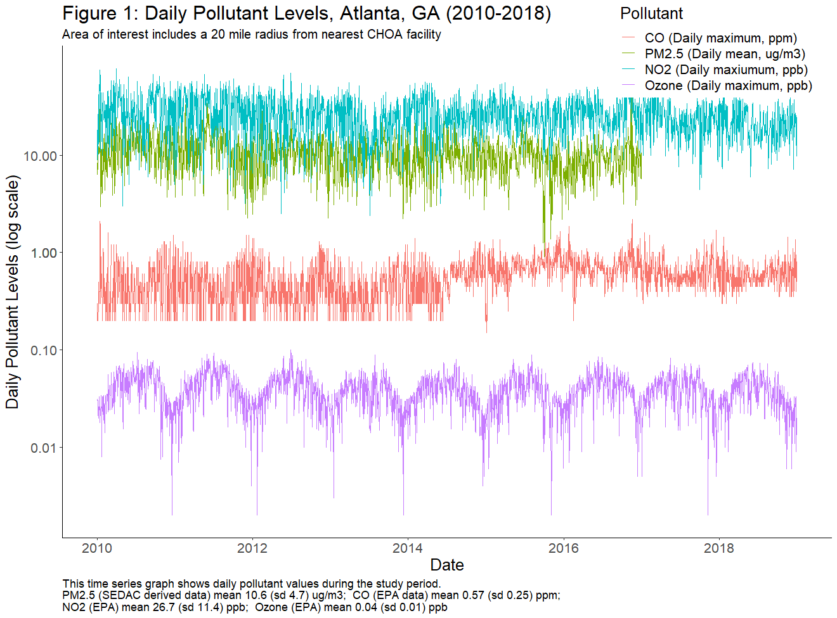

Slide 25
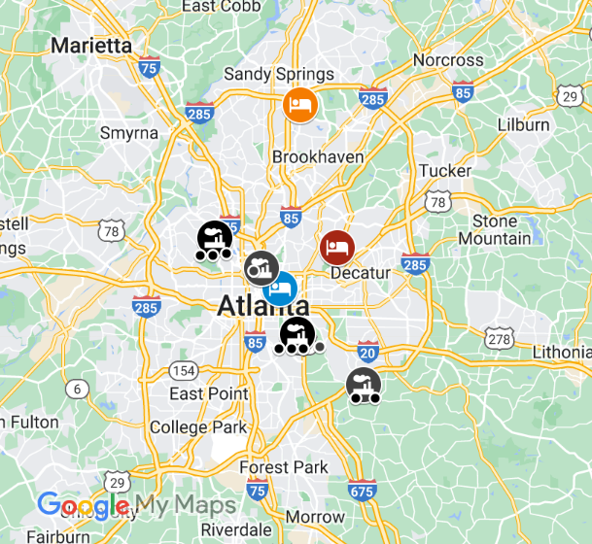
Study Map

Slide 26
103,979 visits
3,384 unique patients
Non-ED
74,184 visits
572 unique patients
29,795 visits
2,812 patients
Age
3,122 visits
168 unique patients
26,673 visits
2,644 patients
Address
8,587 visits
860 unique patients
18,086 visits
1,784 patients
LTFU
355 visits
44 unique patients
17,731 visits
1,740 patients
Notes:
Couldn’t do this study elsewhere

Slide 27
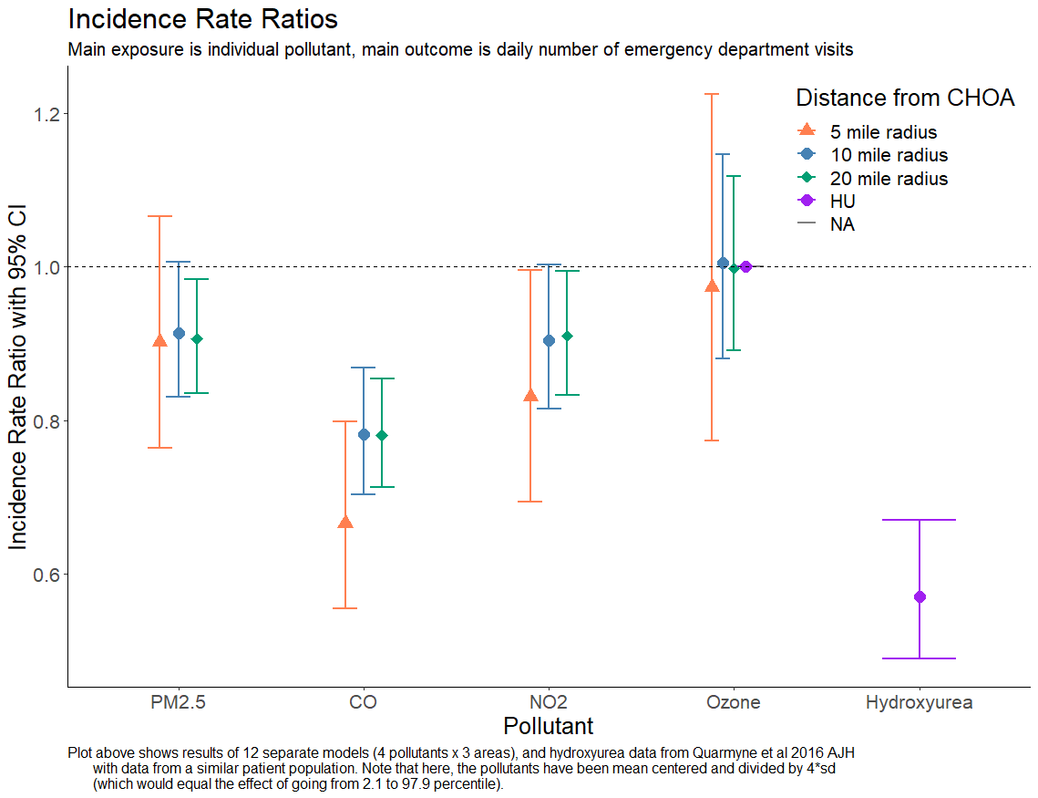
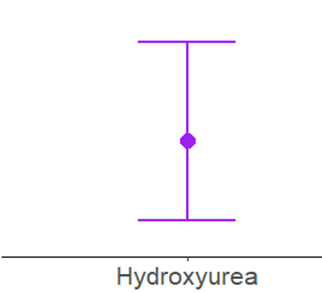

Slide 28
